Slide 1
Square Locator
Katherine G. Czaplicki
Timothy L. Hollingshead
Haoran Liang (Simon)
T. Taylor Purviance

Slide 2
Overview
Math
Procedure
Demo
Issues / Concerns
Q&A

Slide 3


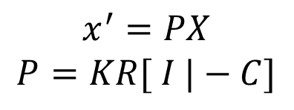

Math
$$x^{′}=PX$$
$$P=KR[ I |−C]$$
$$x^{′}=Hx$$
Source: JP Mellor, and
http://www.epixea.com/research/multi-view-coding-thesisse9.html

Slide 4
Procedure
Camera Calibration
Camera Capture Image
Filter Red Square
Corner Detection
Find Homography
Find Camera Center

Slide 5
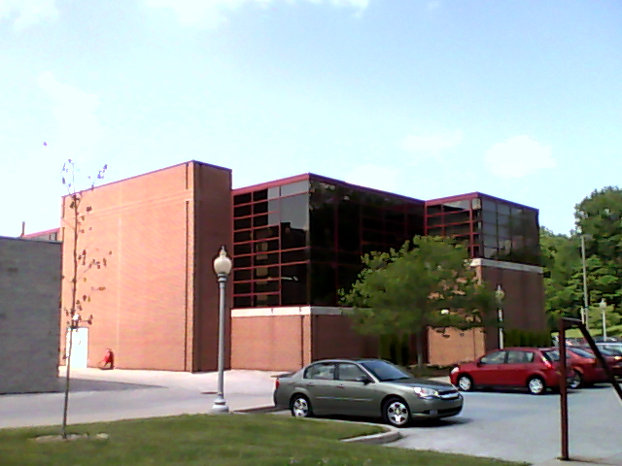
Camera Calibration
Same as PS6
Get K from a picture of Myers

Slide 6
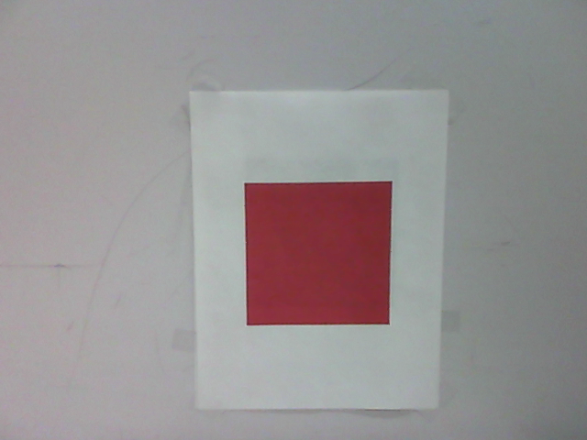
Camera Capture Image
Use MATLAB Video Module

Slide 7
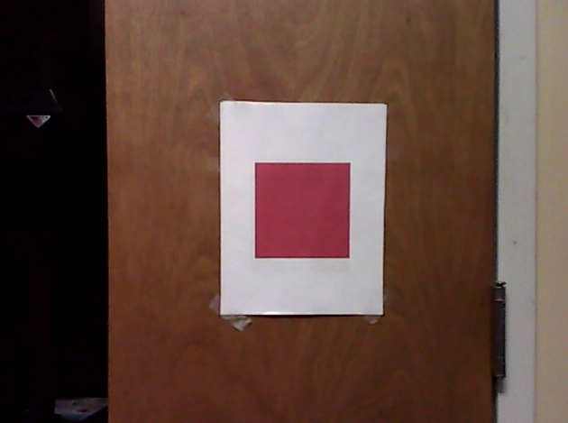
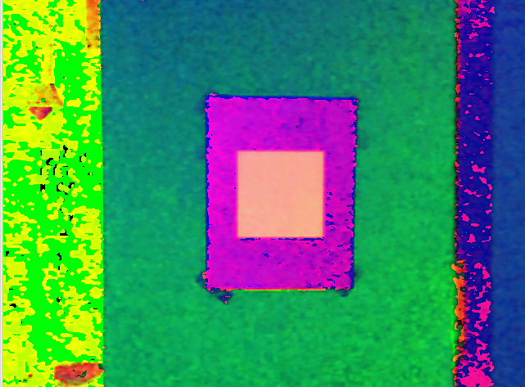
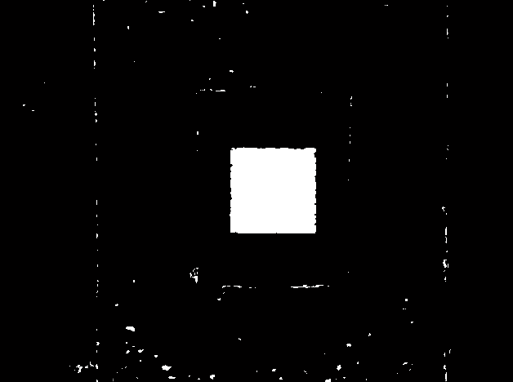

Filter Red Square
Convert RGB to HSV
Find Red Square Based on the Hue, Saturation and Value
Get rid of small noise by counting the pixels for each connected components
Source: Matt Boutell, CSSE 463 Image Recognition

Slide 8
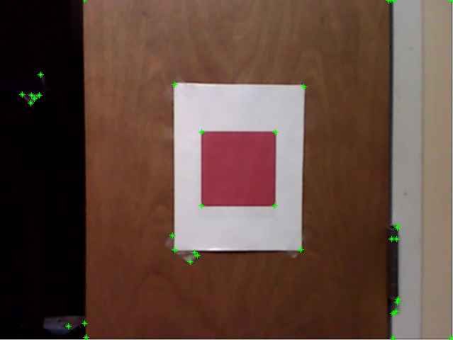
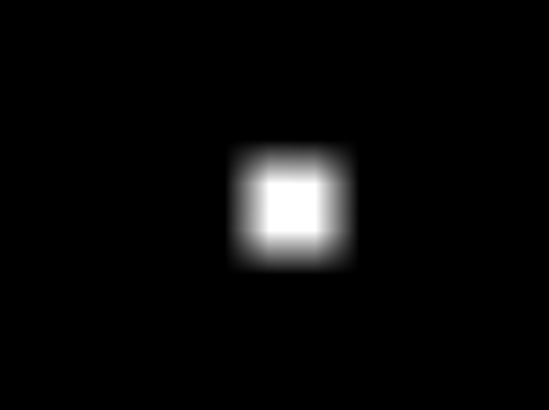

Corner Detection
Find all the possible Corners in the picture using Harris Corner Detection Algorithm
If the corner candidates land on the red square filter, keep them
Blur the red square mask to improve accuracy

Slide 9
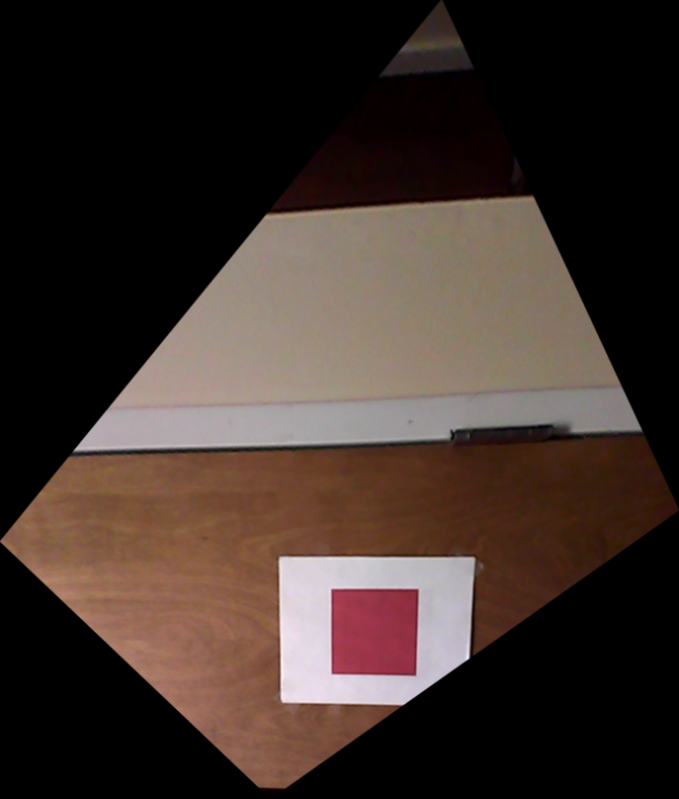
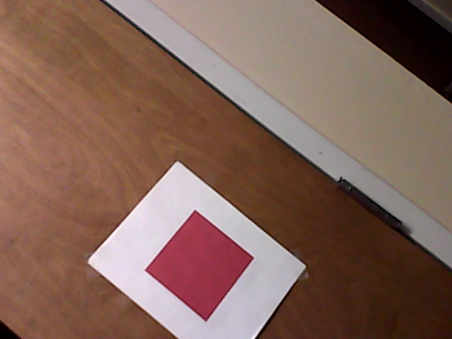
Find homography
Same as PS2
Get H with the real size of the square (1 in. = 100 px) and the corner detector results

Slide 10
Apply the Math
Recover first 2 columns of R and t = -RC by multiplying the inverse of K with H.
Get the 3rd column of R by finding the cross product of the first two columns.
Find C by multiplying the inverse of R by t, then Negating the result.
Magnitude of C = the straight distance from the camera center to the center of the square.

Slide 11
Live Demo

Slide 12
Issues / Concerns
Speed
Accuracy
Interpreting Other Parameters (eg. R matrix)

Slide 13
Questions?

Slide 14
Thank You!

